Slide 1
Project work – 1
Game using c++ and SFML

Slide 2
ADVENTURE ISLAND
Presented by:
Mohammad Akhlaqur Rahman
Reg. No: 2017831011

Slide 3

Game Main Menu

Slide 4
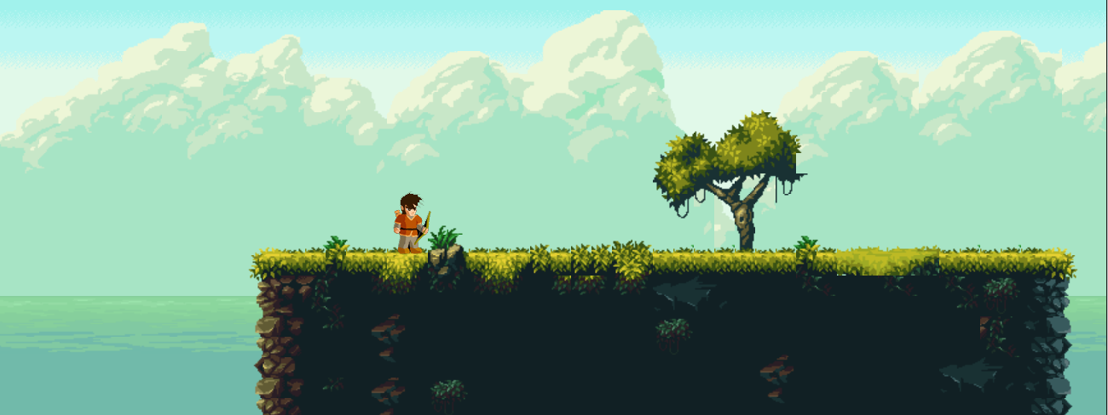
New game

Slide 5
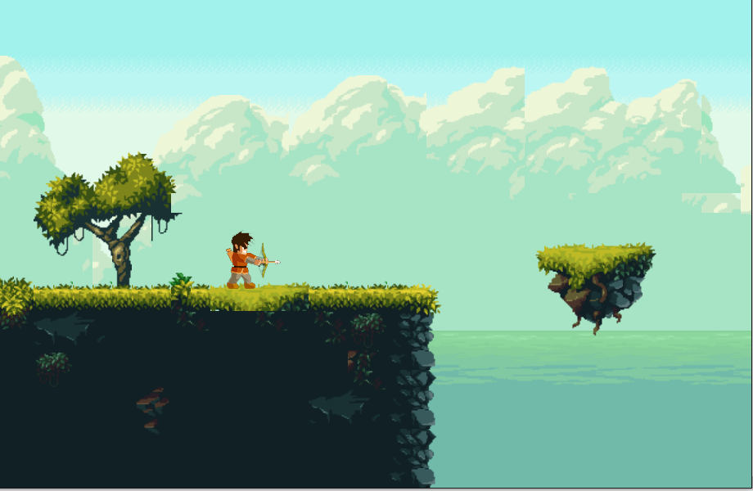
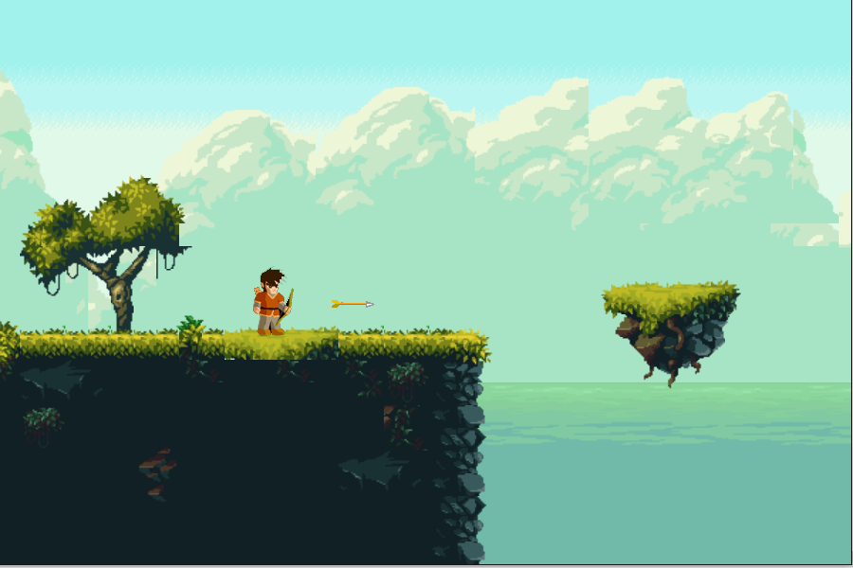
Player attack animation

Slide 6
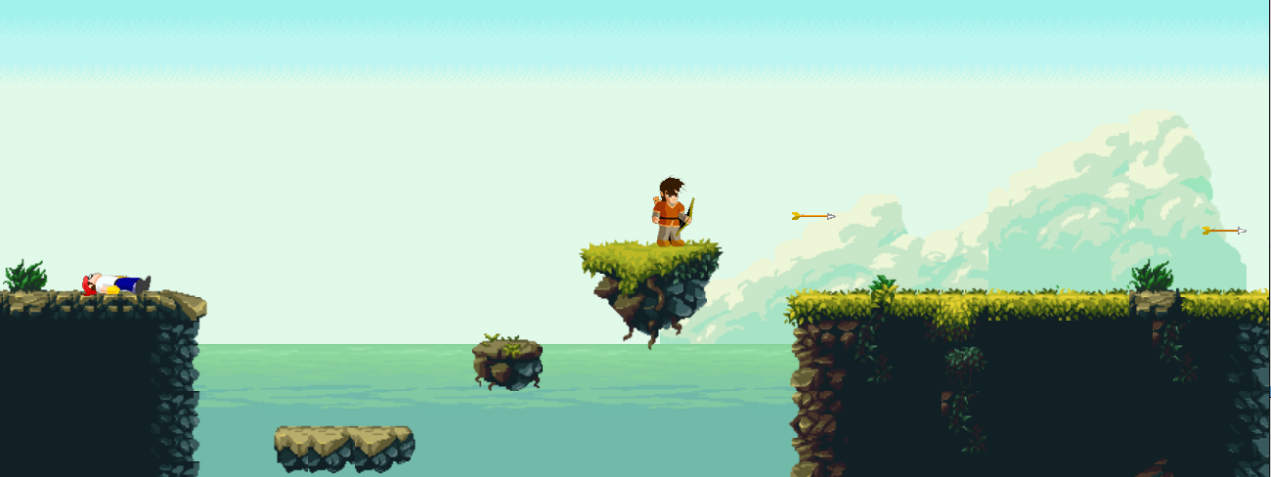
Player shooting arrows

Slide 7
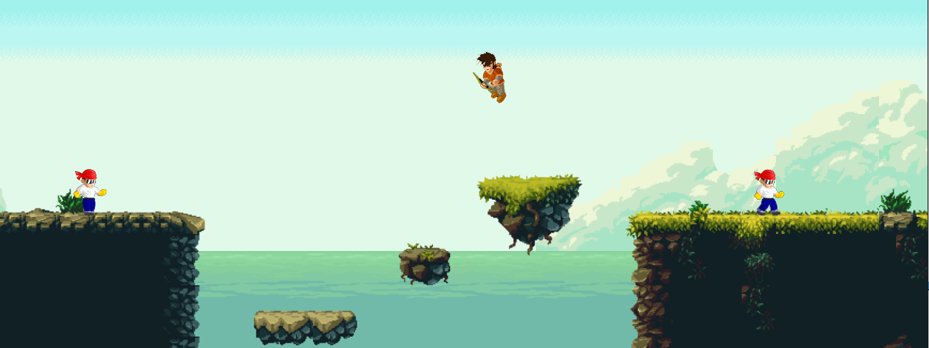
Player jump

Slide 8
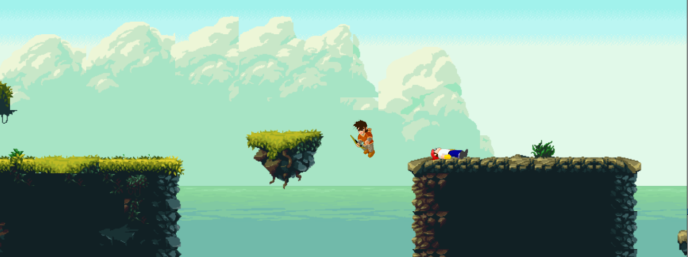
Player falling off a platform

Slide 9
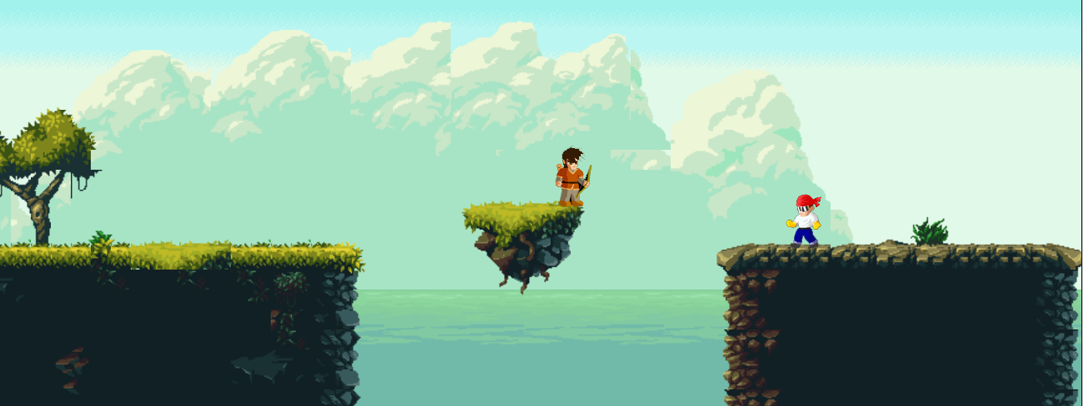
Enemy

Slide 10
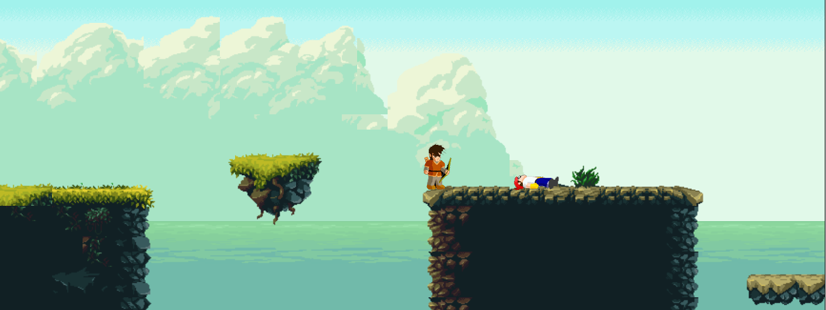
Enemy death

Slide 11
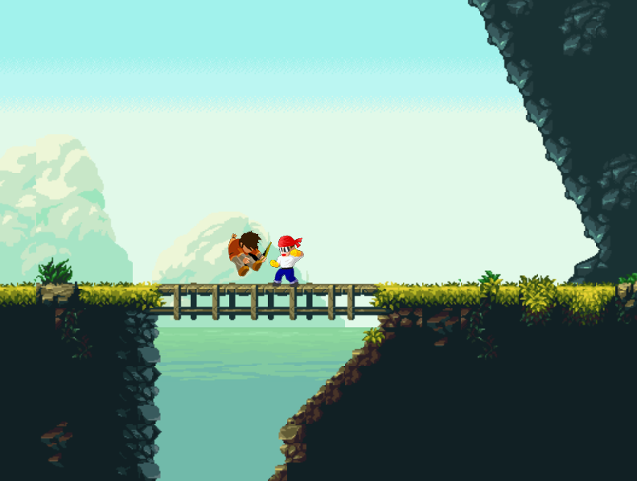
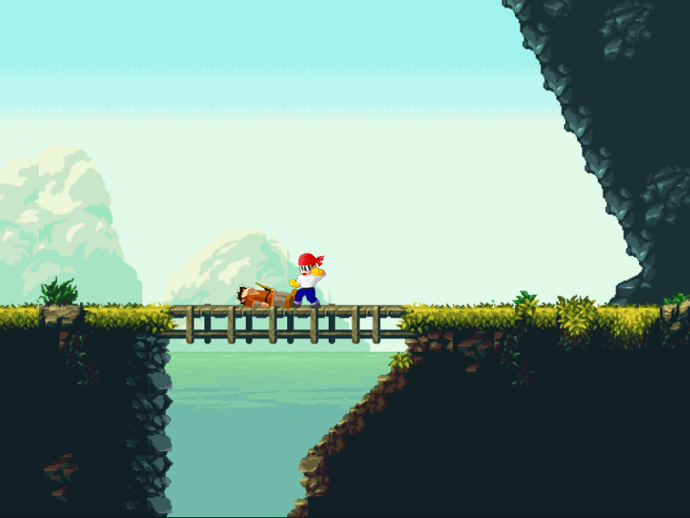
Enemy attack and player death animation

Slide 12
That is all, Thank you.

